Slide 1
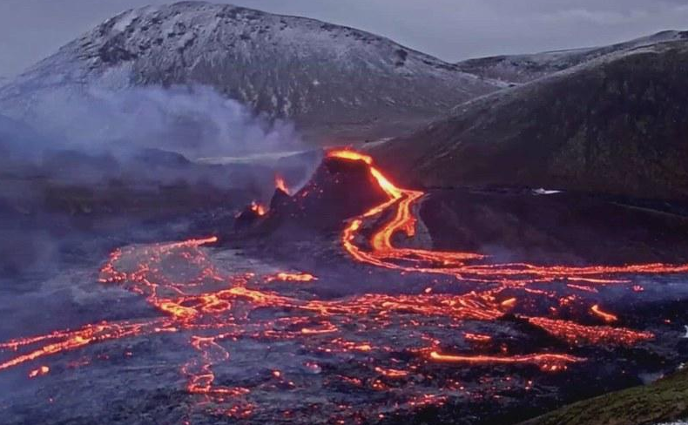
Volcanic Eruptions
Tristan Mercier
By: Tristan

Slide 2
Introduction
Negative/Positive Effects on
economy, people, and environment.

Slide 3
Negative

Slide 4
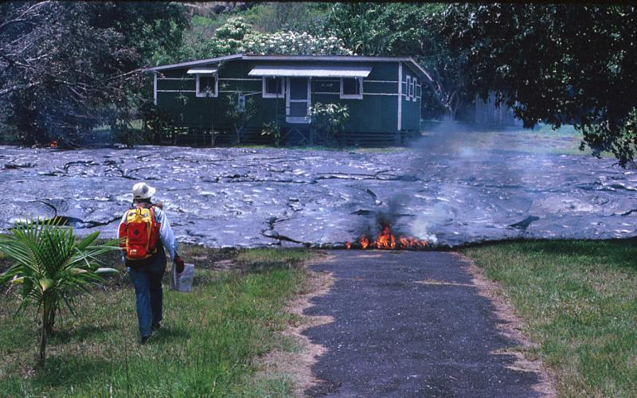
Notes:
Talk about how it damages people's houses and other structures.

Slide 5
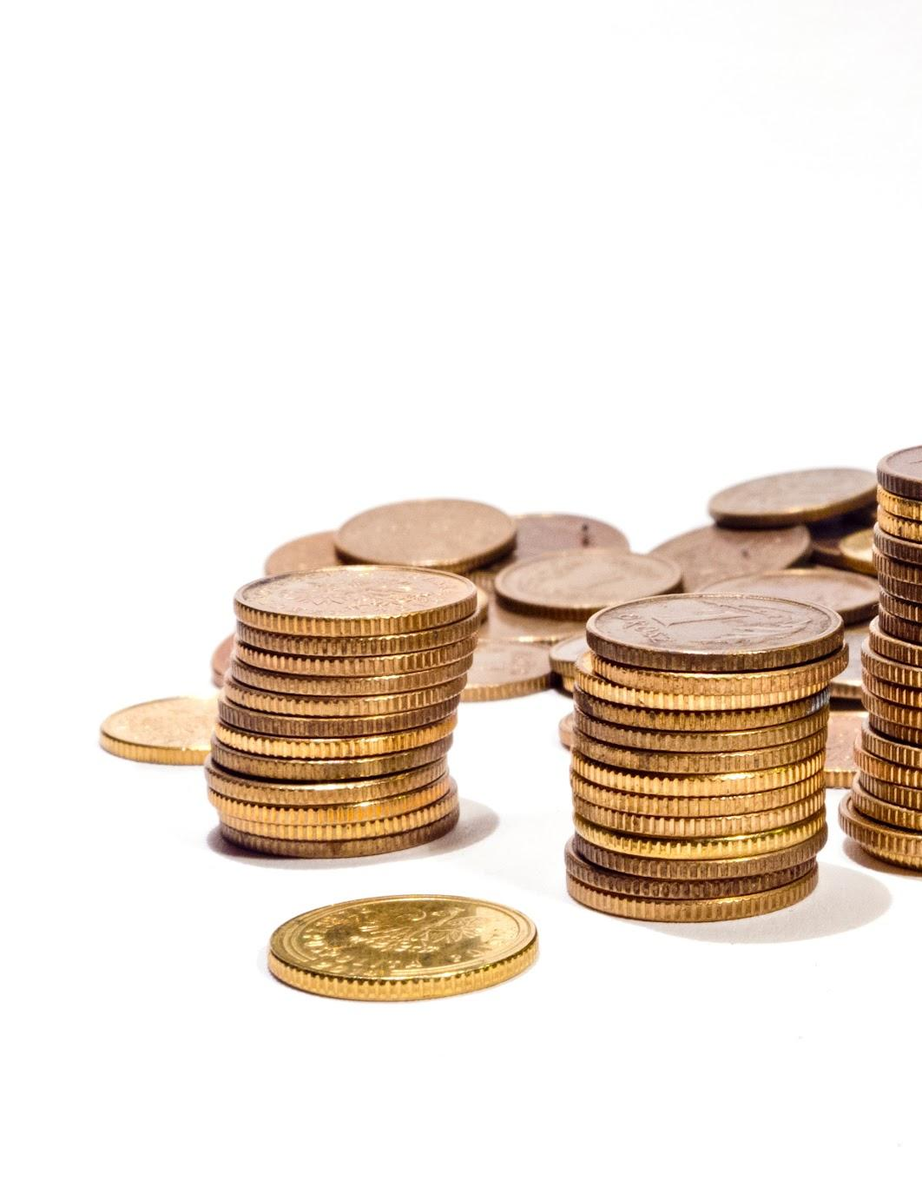
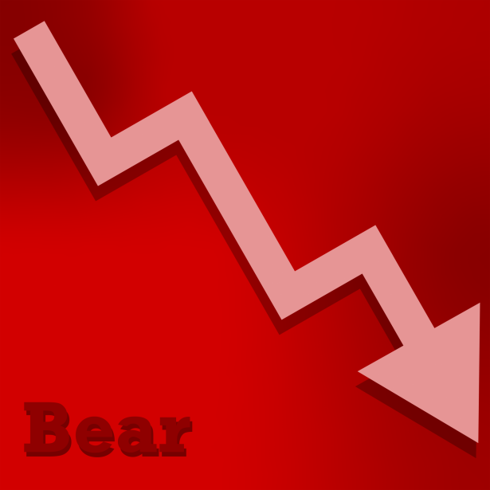

Slide 6
$1,000,000,000

Slide 7
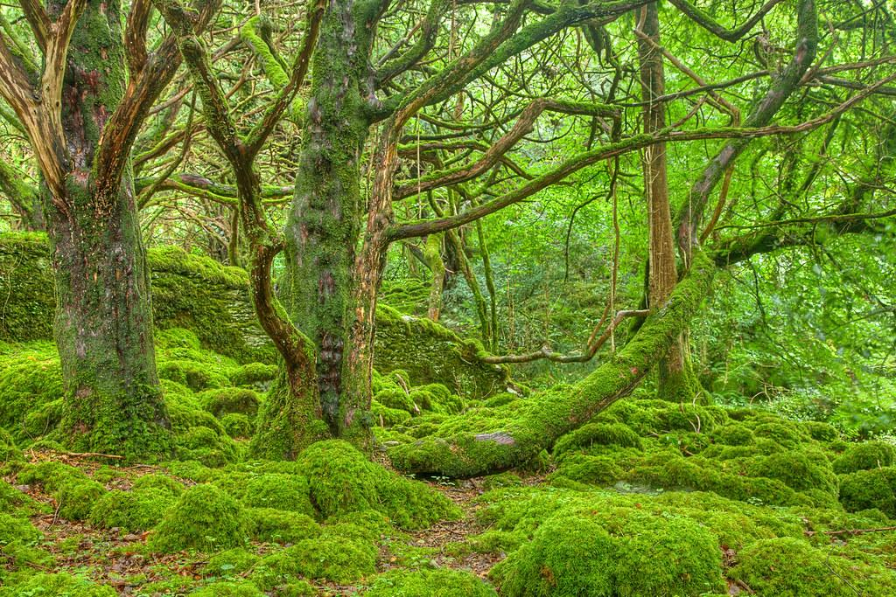
Notes:
Talk about how it harms the environment

Slide 8
Positive

Slide 9
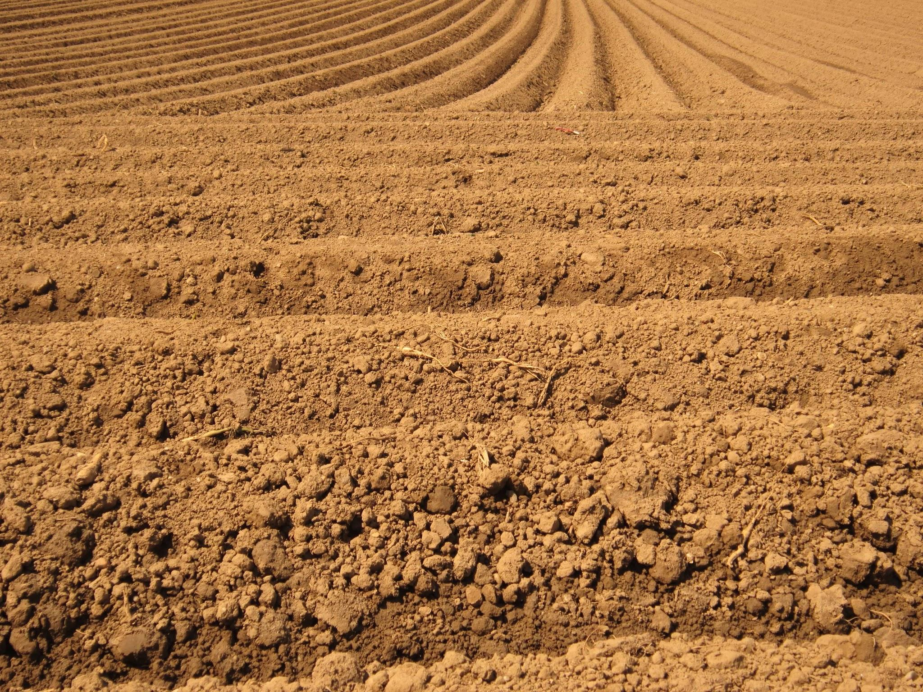
Fertile Soil

Slide 10
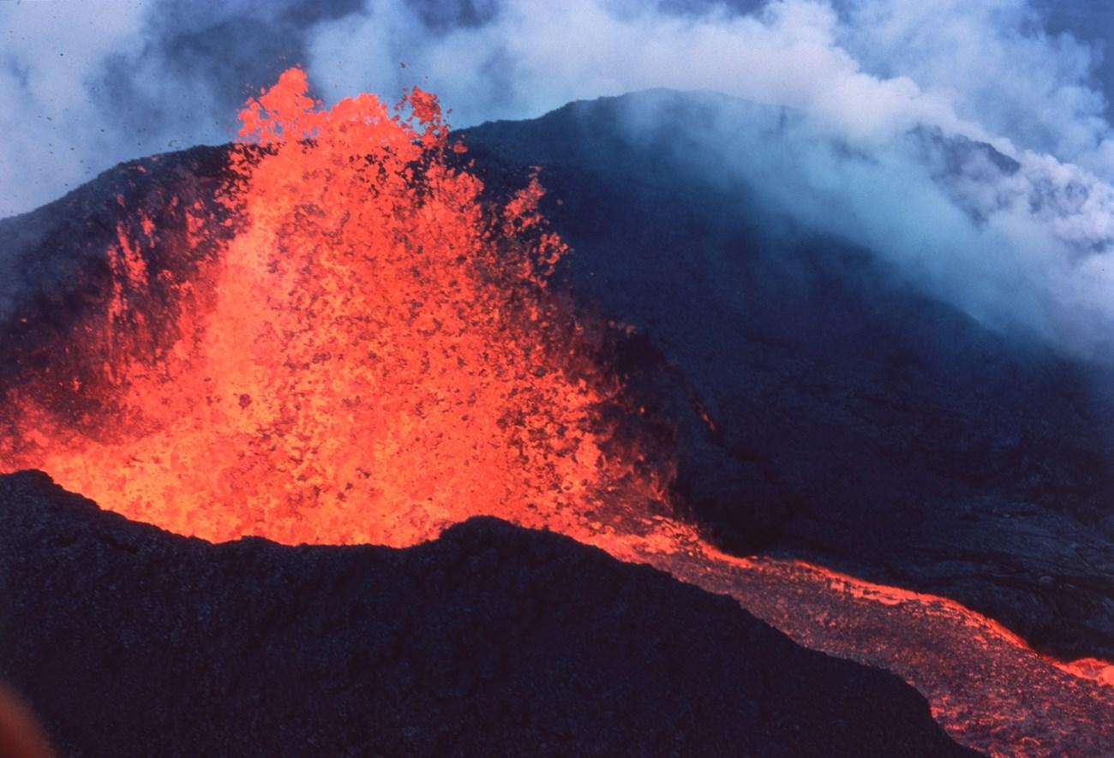

Slide 11
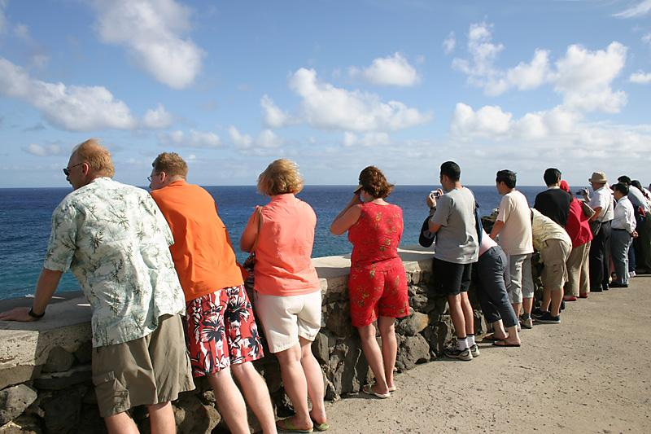

Slide 12
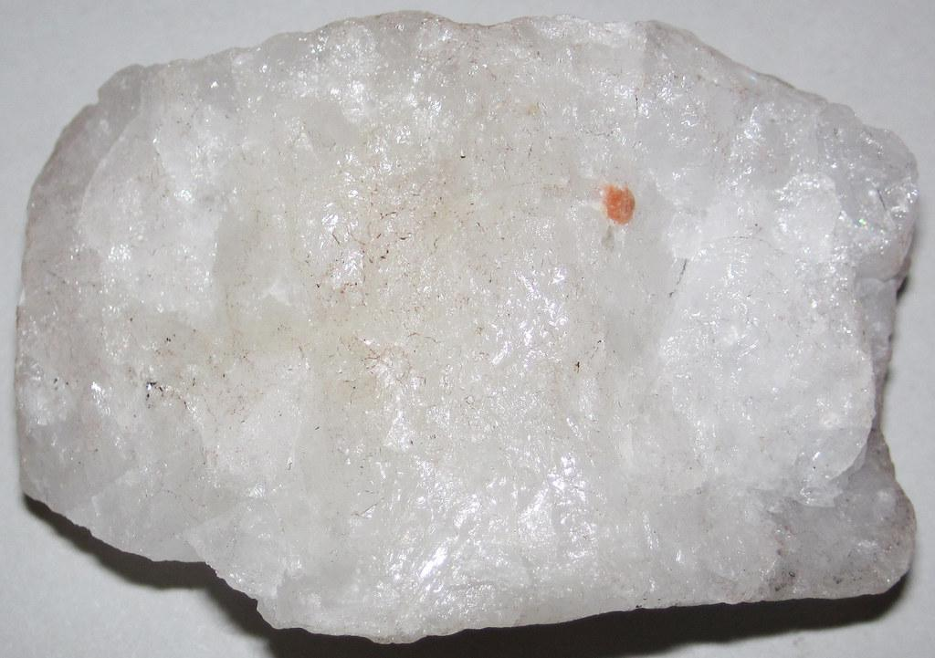

Slide 13
Other/Facts

Slide 14
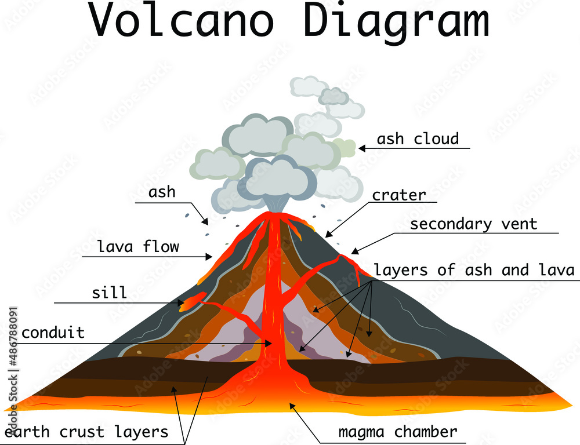

Slide 15
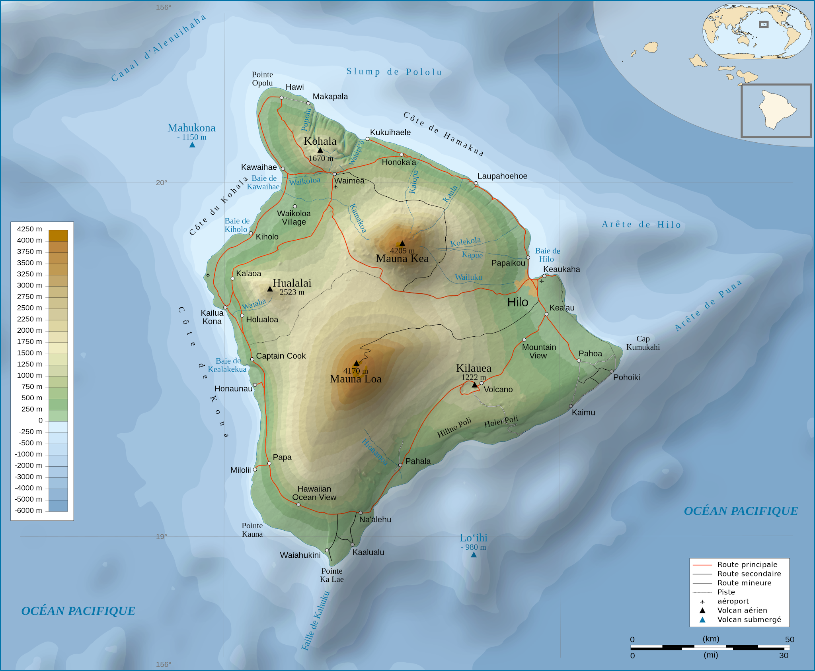

Slide 16
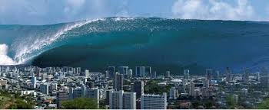

Slide 17
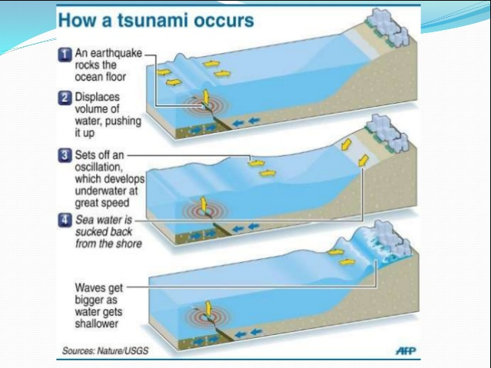

Slide 18
1000

Slide 19
Any Questions?

Slide 20
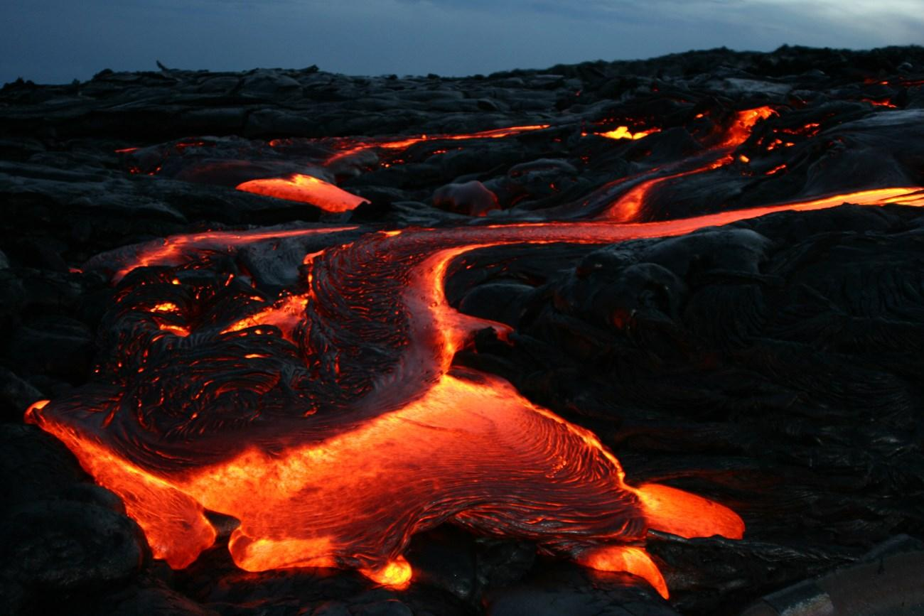
I hope you learned:
Negative/Positive Effects on
economy, people, and environment.

